Slide 1
Efficient Computation of Flooding Scenarios for the Coast of Maine
Corinne Alini ‘18
Faculty Advisors: Laura Toma & Eileen Sylvan Johnson
Supported by the Rusack Coastal Studies Fellowship

Slide 2
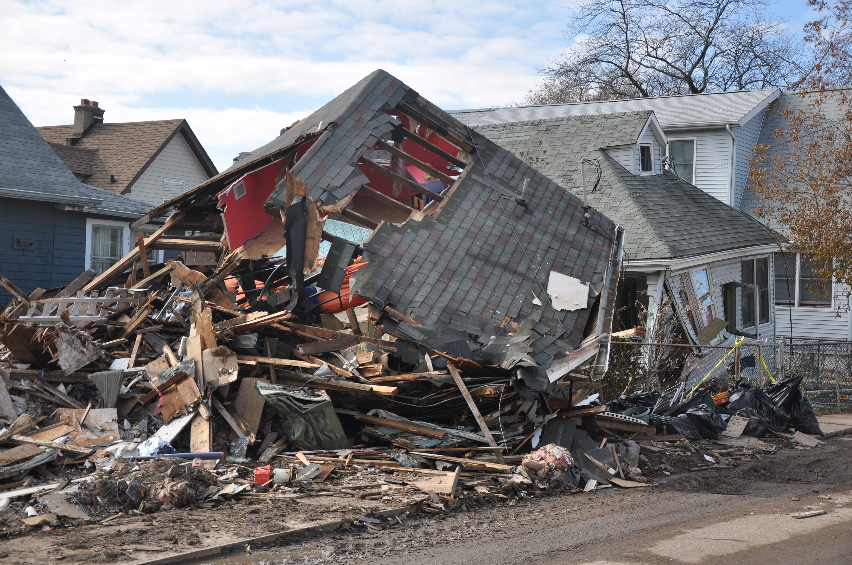
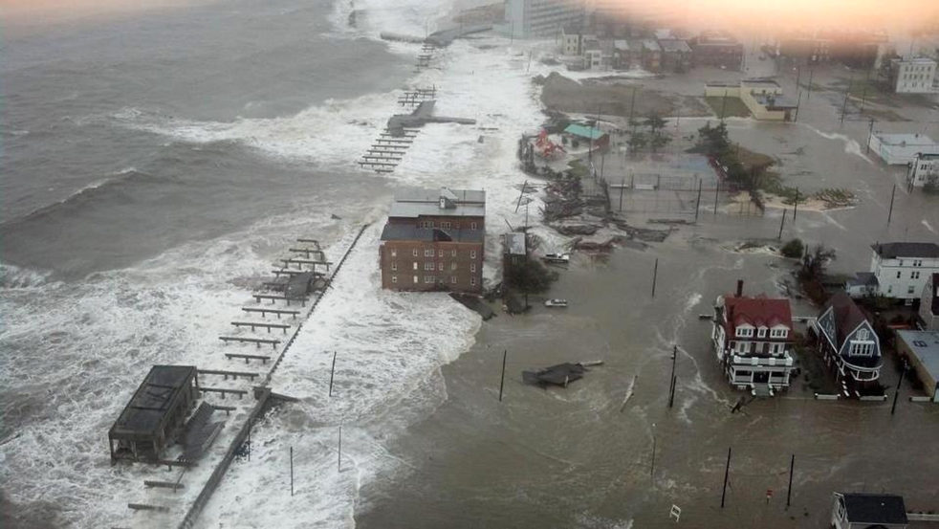
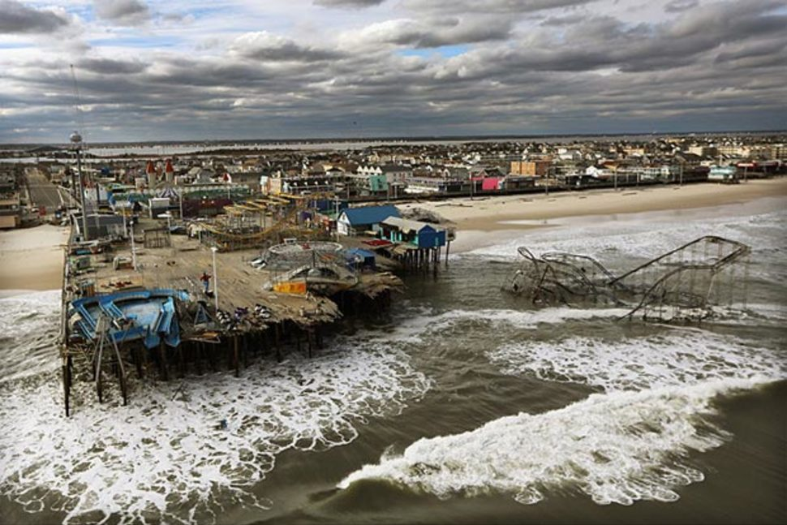
October 29, 2012
Figure 1: Destruction of Sandy
Notes:
Sandy caused devastation
Why couldnt we predict sandy

Slide 3
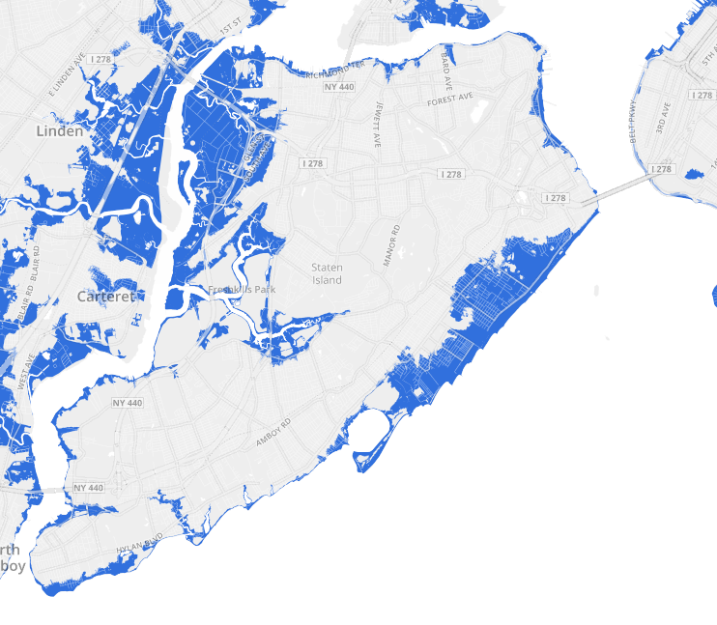
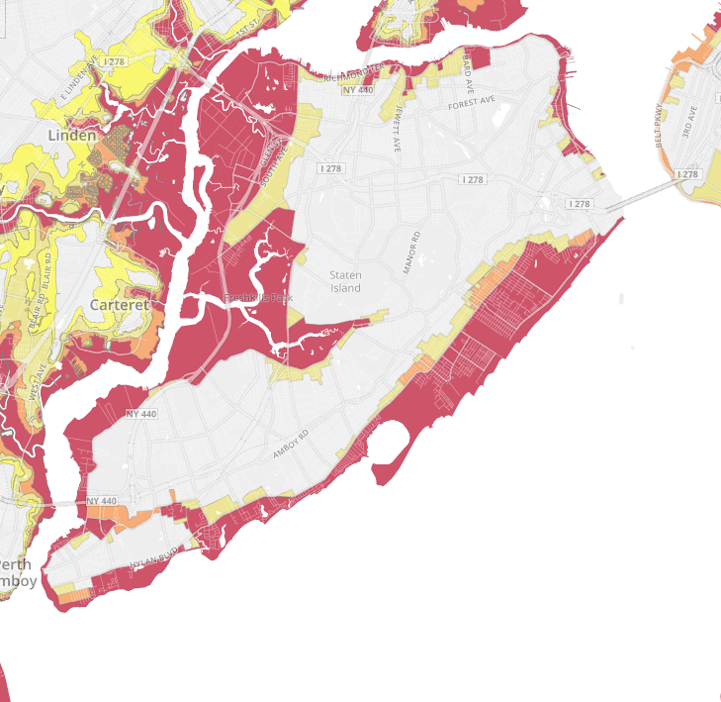
Figure 2
Predicted
Actual
Notes:
https://project.wnyc.org/flooding-sandy-new/#12.00/40.7378/-74.0702

Slide 4
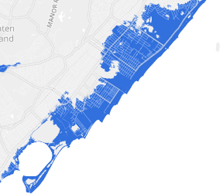
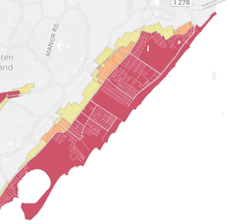
Predicted
Actual
Notes:
https://project.wnyc.org/flooding-sandy-new/#12.00/40.7378/-74.0702

Slide 5
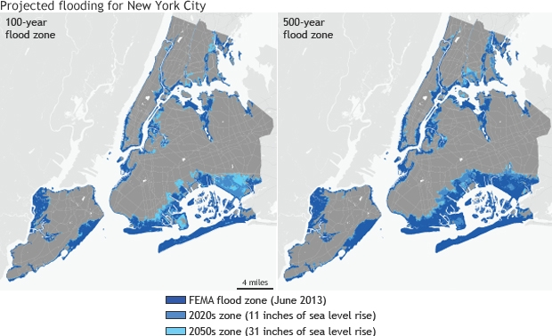
Figure 3: FEMA Flood Maps June 2013
Notes:
Put date on this slide: New FEMA flood zones, 2013 (so that its clear that it happened after Sandy)
https://www.climate.gov/news-features/featured-images/future-flood-zones-new-york-city
Since then, noaa and coastal states have started this big effort to update their floodmaps based on slr.
The goal: extend basic flood plain to make them incorporate slr

Slide 6
Modelling flood

Slide 7
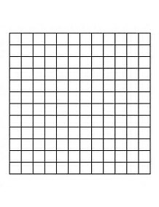
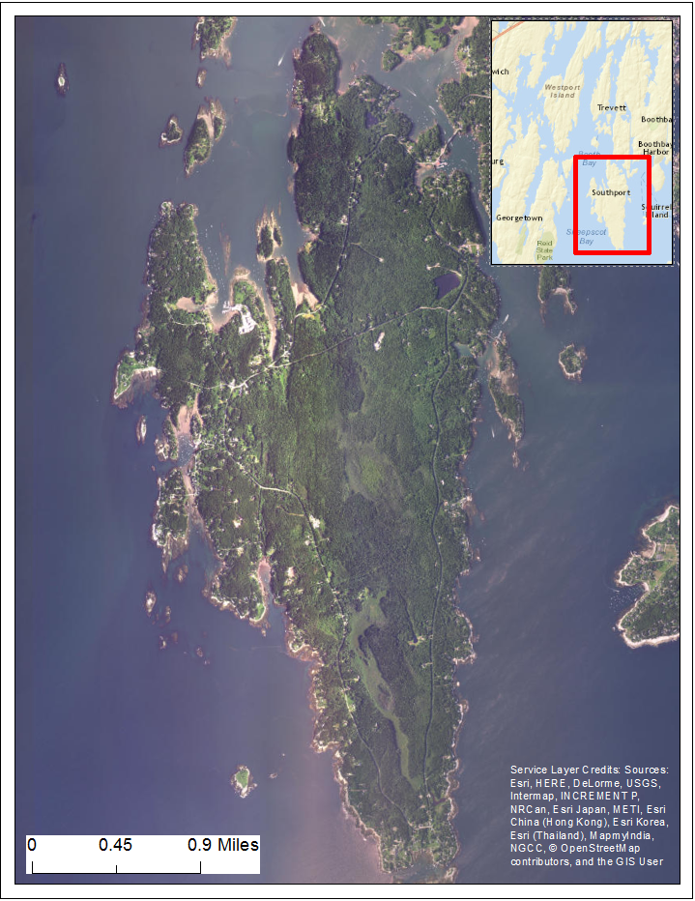
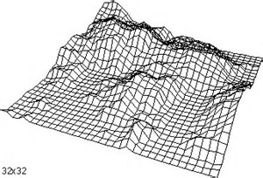
Surface models
Notes:
To model flood, we need a model of terrain. The most commonly used model is the GRID. Basically we assume that the terrain is given to us as a grid, which represents the elevations in the terrain.
Grid models of terrain are obtained from satellite imagery, and more recently they can obtained from LiDAR technology.

Slide 8
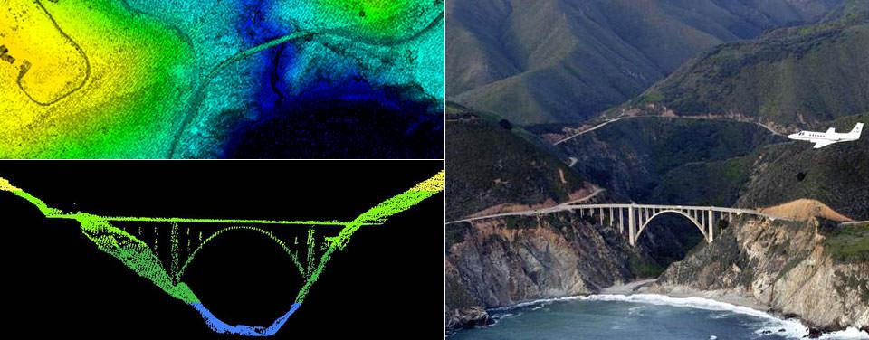
LiDAR data
https://aamboceanservice.blob.core.windows.net/oceanservice-prod/facts/lidar.jpg
Notes:
Lidar data is very high resolution, down to 1m and below, and has great vertical accuracy (10-20 cm).
Grids obtained from LidAR data are very high resolution and basically they represent the best data available.

Slide 9
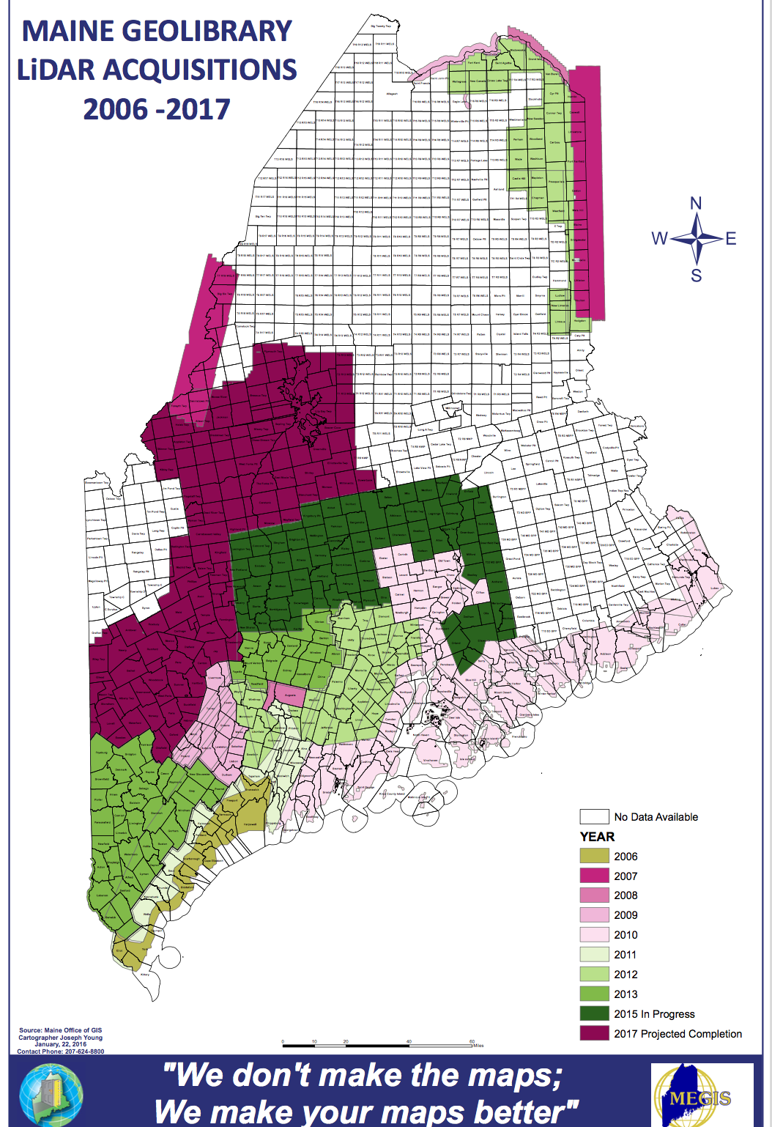
Maine LiDAR data
Notes:
LiDAR data is becoming common and Many states have at least partial coverage with high-resolution DEMs obtained from LIDAR technology.
We see all the coast has been mapped and part of inland

Slide 10
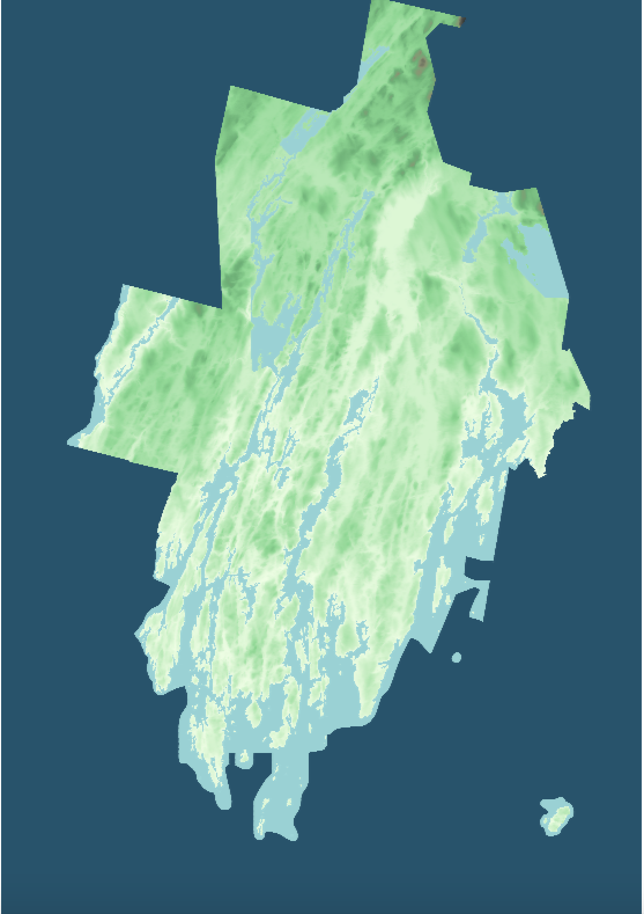
Lincoln county, 2m resolution, 1 billion points
Notes:
LT: show a picture of Lincoln county, at 2m resolution, and show how many points. Message: lidar data is large.

Slide 11
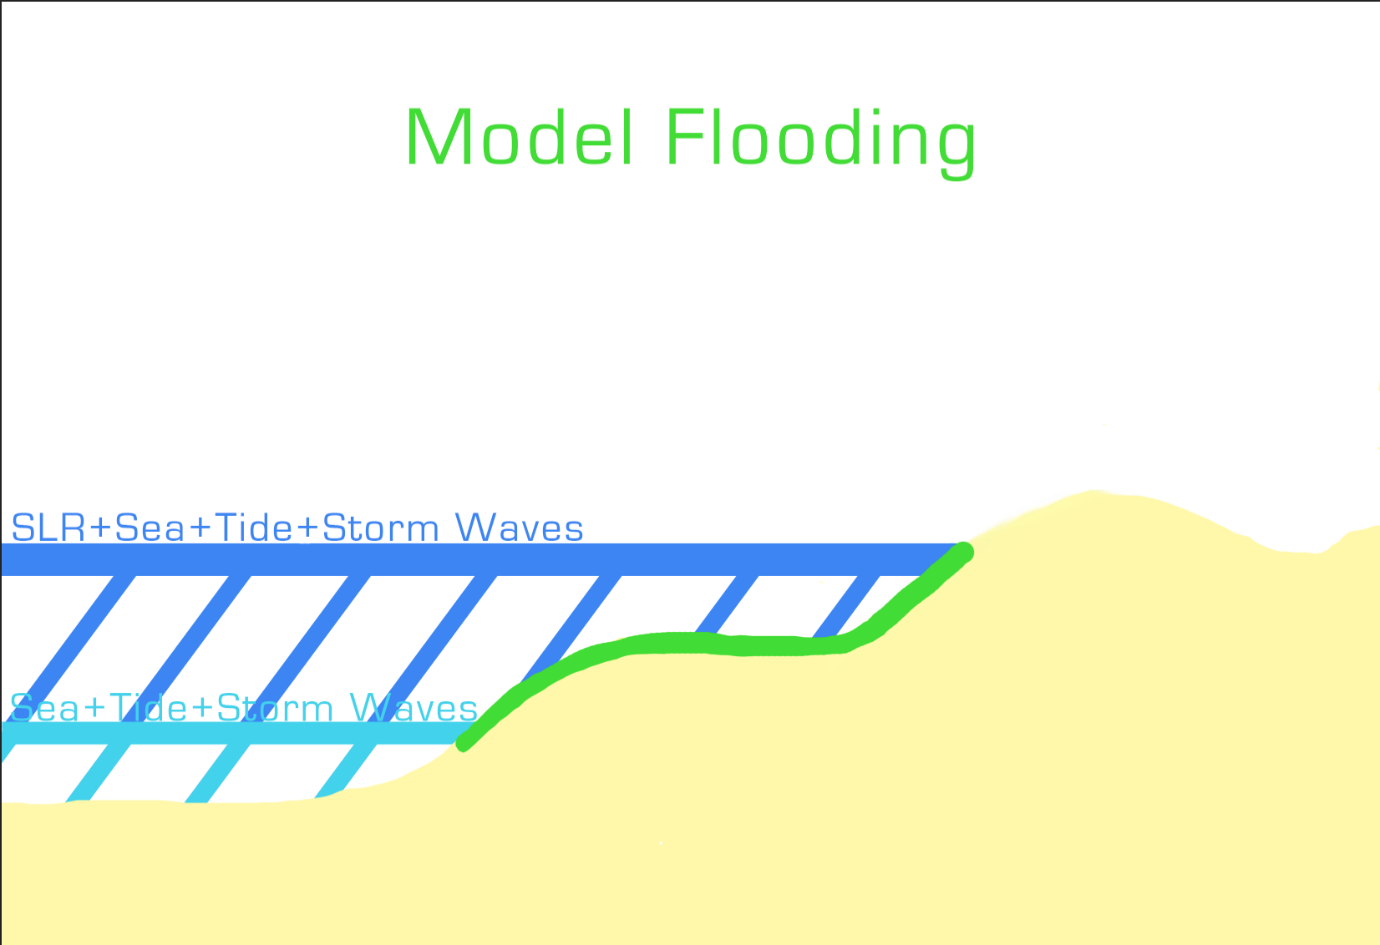

Slide 12
Modeling flooding
A point is flooded if
its elevation is below the elevation of the ocean
and
the ocean can reach it (via a path of flooded points)
Algorithm idea: Simulate inundation coming from the coast. For each point on the coast, check if it is flooded. If it is, check its neighbors. Repeat.
Notes:
There are two conditions that need to be met
Elevation itself isnt sufficient (lakes ex)

Slide 13
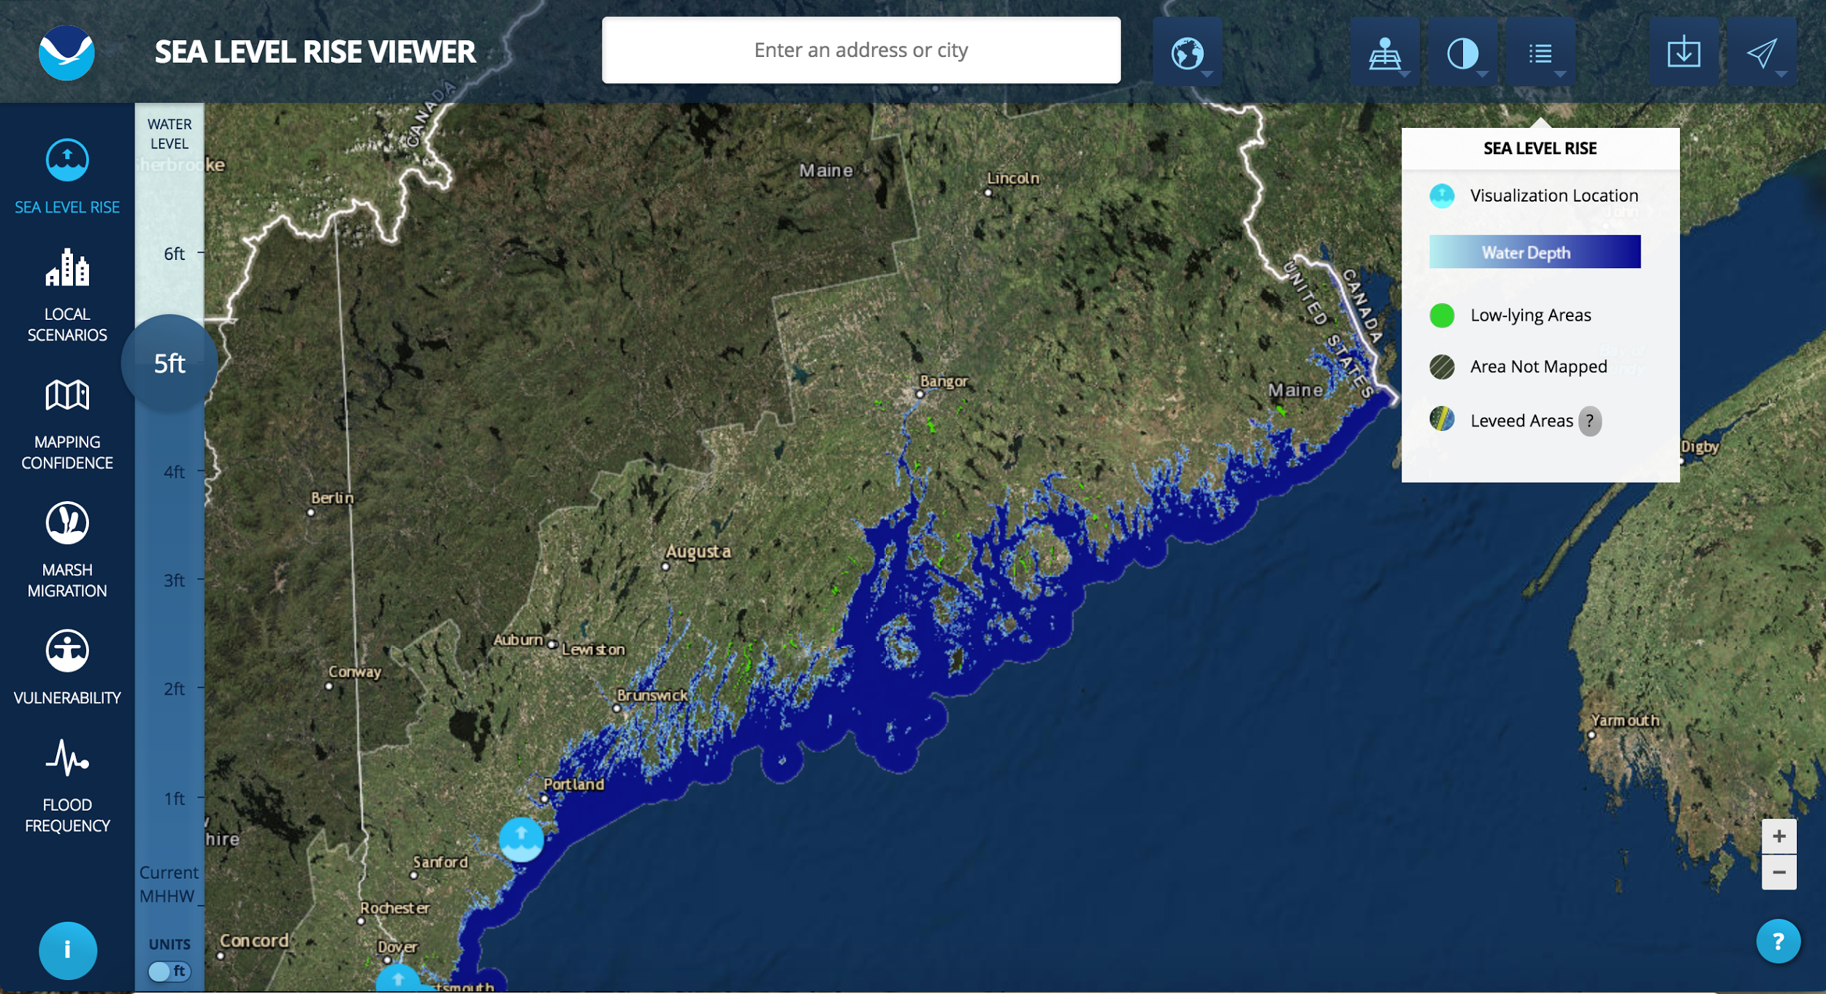
Related work
NOAA sea level rise viewer (https://coast.noaa.gov/slr/)
Data: NED 10m resolution
Flooding is precomputed, users can visualize various scenarios
Notes:
There is a body of work on modeling and viewing SLR.
For example, NOAA SLR viewer, available 2012, is using NED for the entire US at 10m res. Has precomputed flooding due to SLR on top of high tides, at various increments between 1ft and 6ft. The users can select the area that they are interested and visualize the effect of flooding. For e.g. this is the coast of Maine

Slide 14
Related work
States are developing their own models and maps using high resolution LiDAR data, and incorporating storm flooding.
Implemented in ArcGIS
Flooding modelled via a sequence of steps
Tedious
Cannot handle large data well (use tiling)
Notes:
States rely on higher resolution data and model storm flooding which noaa does not

Slide 15
Goals
Use high resolution data (LiDAR 1-2m res)
Model slr and tides
(e.g. What will get flooded by high tide when sea rises 1 ft)
Model slr and storms
(e.g. What will get flooded by storms when sea rises 1 ft)
Outside ArcGIS, simple, efficient, open source

Slide 16
Results

Slide 17
DEM
(digital elevation model)
Cory’s open-source, super-efficient flood model
Flooded grid
Flood zones
Rise (xx ft)
Notes:
say that you have a module that takes in the elevation model, a rise (like 3ft) and optionally a map of flood zones, and computes either:
If only a DEM and a rise are specified, computes the part of the terrain that’s flooded with that SLR
If a flood map is specified, your code essentially computes what the floodzones become with that SLR

Slide 18
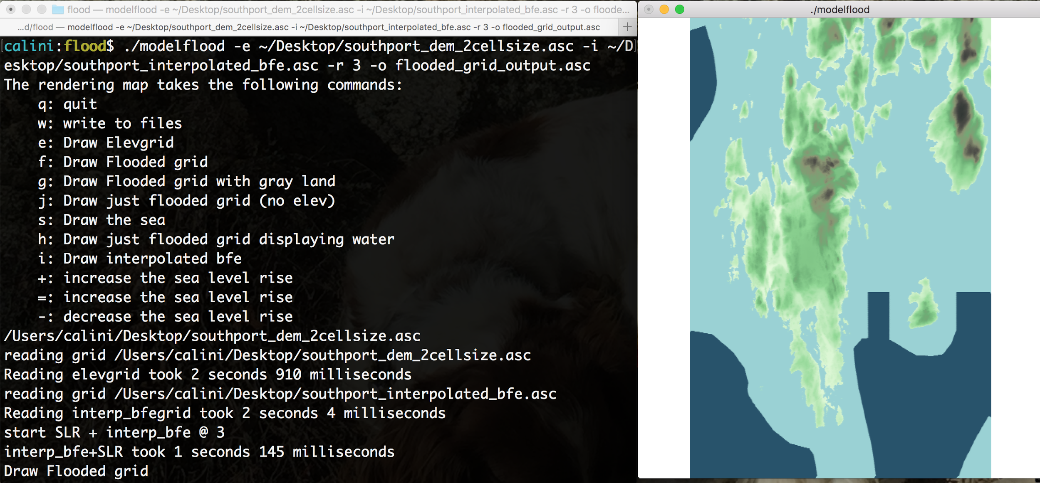

Slide 19
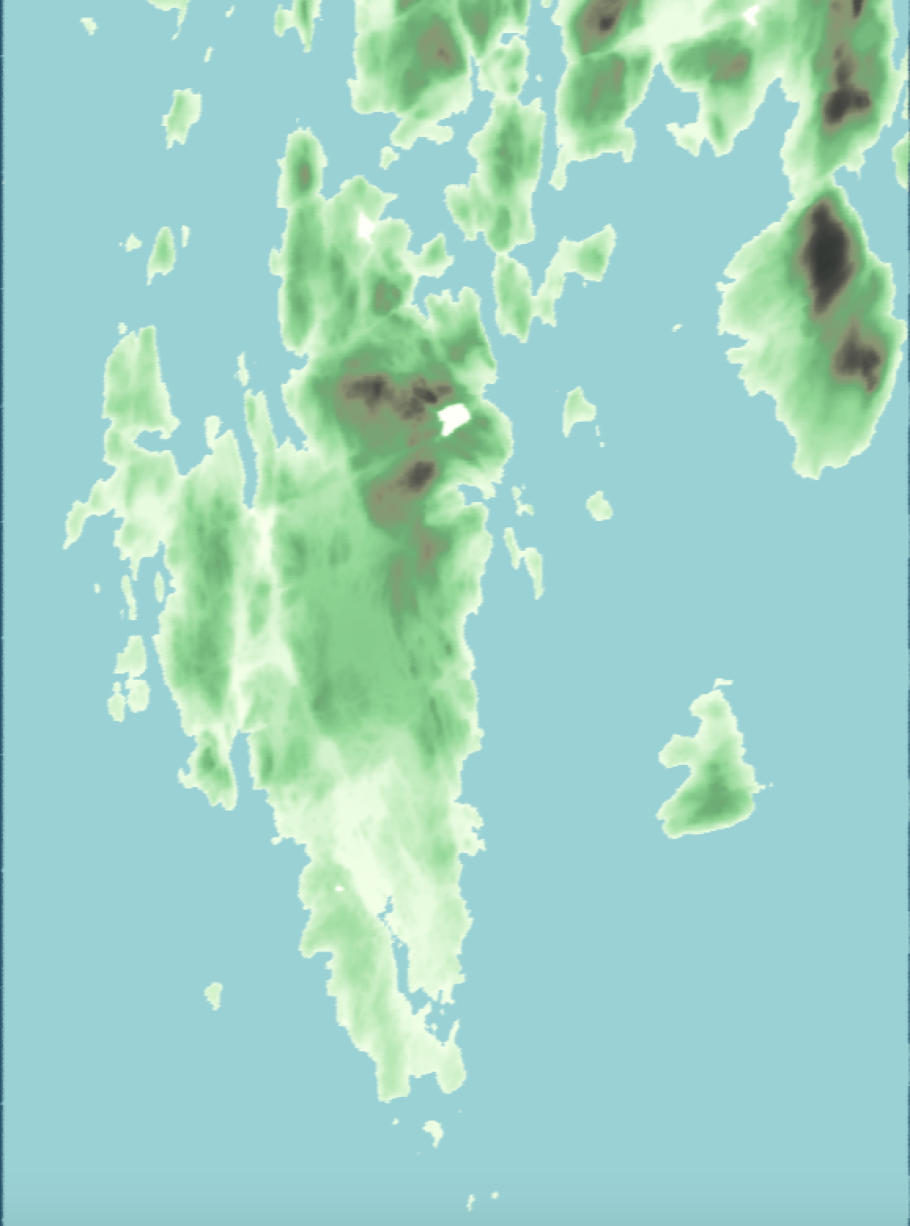
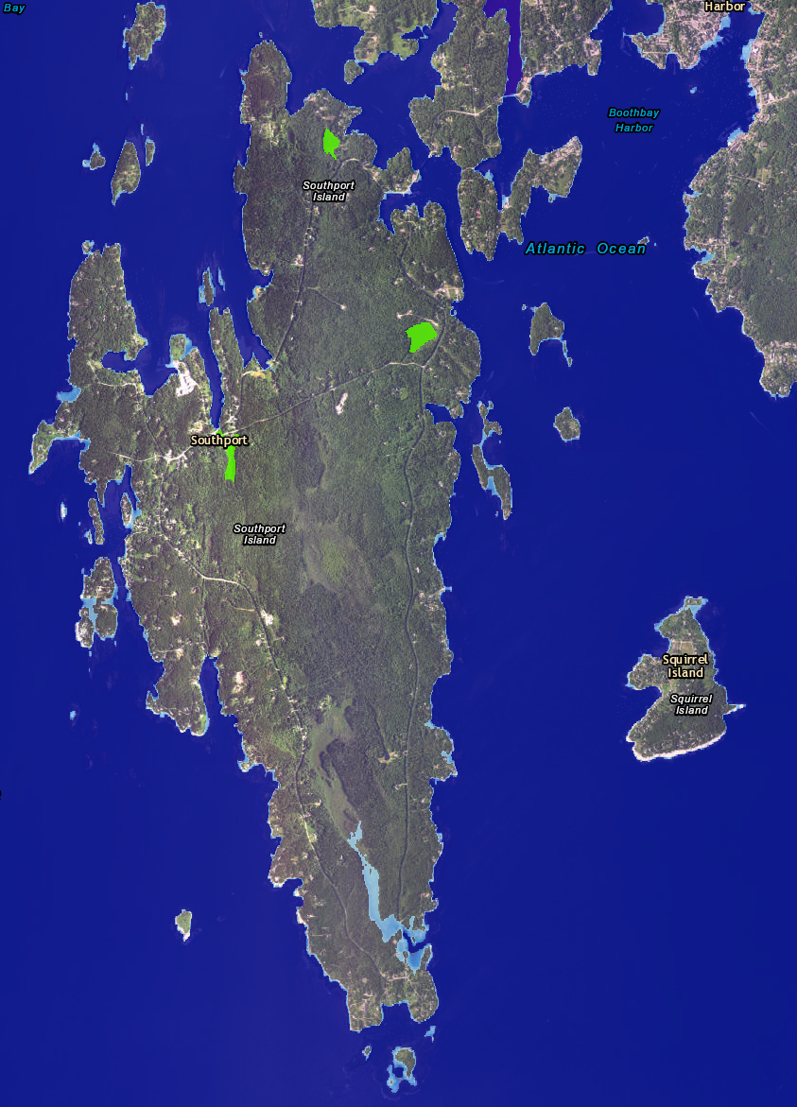
Results similar to NOAA SLR viewer
This Project
NOAA
Notes:
Message: Your code gives very similar results as NOAA SLR viewer
This closeup shows it better
6ft SLR

Slide 20
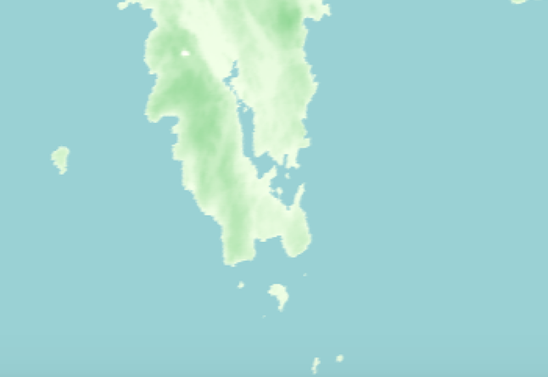
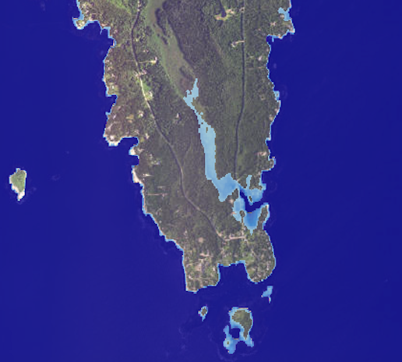
It works!
This Project
NOAA
Notes:
Message: Your code gives very similar results as NOAA SLR viewer
6ft SLR

Slide 21
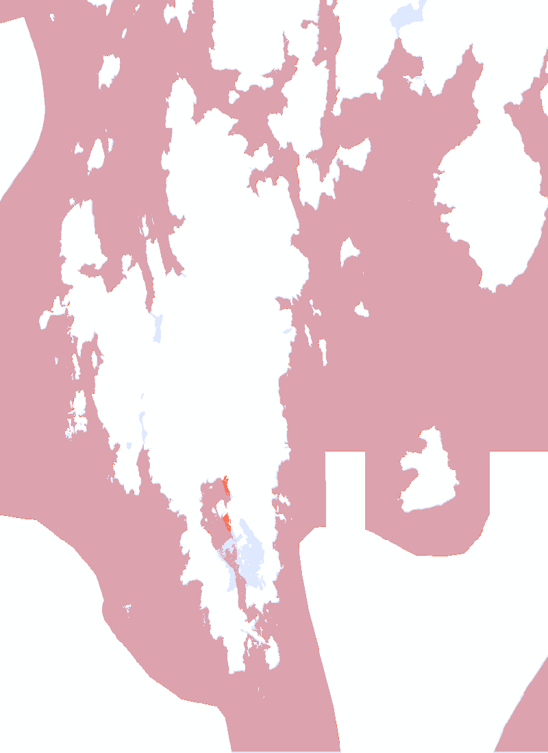
It works!
Notes:
Also, you spent a large part of the summer validating with the results obtained in ArcGIS by a previous Bowdoin student.
This picture shows the differences between the flooded computed by our module, and the flooding computed with the same data and same parameters, in ArcGIS by professor Eileen Johnson and her student.
We see that they are almost identical except some small patches and this big area here is due to a difference in how we interpolate, and that’s something that I am planning to fix.
We can run a 6.5GB grid, which has 1billion points in 2 minutes git st

Slide 22
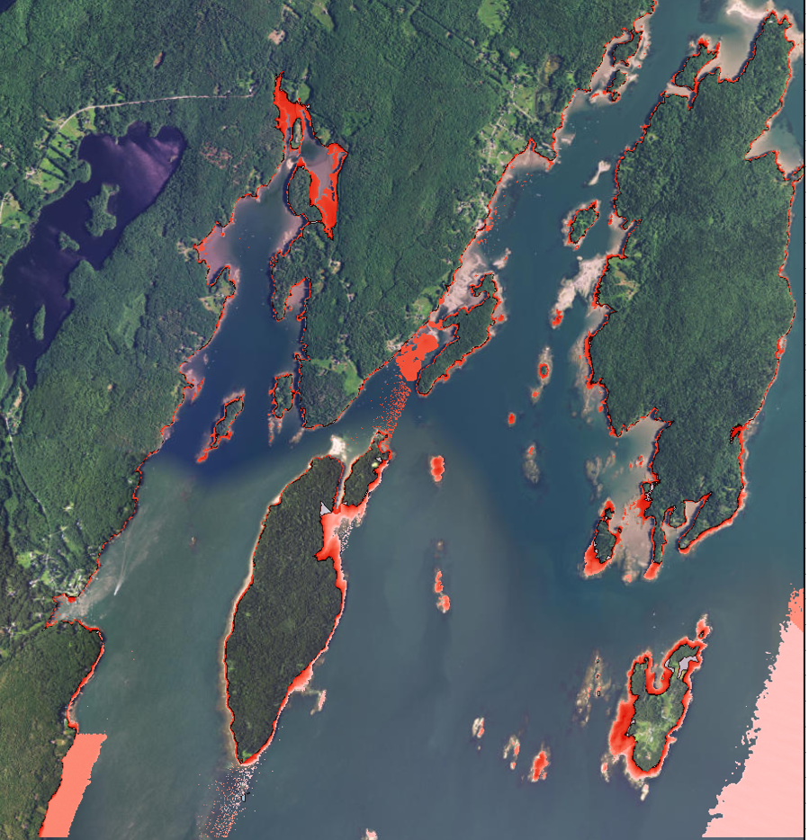
Bremen, ME
LiDAR 2m res
1ft SLR
Flooding created by this project
Notes:
Here is another section of the coat, the town of Bremen. Again, Lidar data at 2m resolution. And this image shows how Bremen coast will be flooded with 1ft of SLR, as computed by our module.
(the results are very close to the results obtained in ArcGIS by prof Johnson and her previous student).

Slide 23
Summary
Pros:
Much simpler to use than ArcGIS
Efficient (e.g. Lincoln county in under 3 minutes)
Free and open source
Versatile (combines SLR+tidal datum with SLR+storm)
Can be easily extended

Slide 24
Thank you!
Acknowledgements
Bowdoin Rusack Coastal fellowship
Professor Eileen Johnson and Professor Laura Toma

Slide 25
References
Pictures, Michael Shaw Reading The. "Sandy: Sin City." Reading The Pictures. October 29, 2012. Accessed July 20, 2017. http://www.readingthepictures.org/2012/10/sandy-2-a-threat-to-our-very-way-of-life/; Soliwon, Diana. "20 Then-and-Now Photos of Hurricane Sandy." U.S. News. October 29, 2013. https://www.usnews.com/news/articles/2013/10/29/photos-hurricane-sandy-then-and-now.;Emergency Blog. Accessed July 20, 2017. https://emergencyblog.americares.org/2012/12/helping-staten-island-communities-recover/dsc_0698/.
"Flooding and Flood Zones | WNYC." Project.wnyc.org. Accessed July 20, 2017. https://project.wnyc.org/flooding-sandy-new/#12.00/40.7378/-74.0702.
Future Flood Zones for New York City | NOAA Climate.gov. March 18, 2014. Accessed July 20, 2017. https://www.climate.gov/news-features/featured-images/future-flood-zones-new-york-city.
"Flood Maps And Flood Zones." Flood Elevation Surveyors. Accessed July 20, 2017. http://floodelevationsurveyors.com/flood-zones.html.
US Department of Commerce, National Oceanic and Atmospheric Administration. "What is LIDAR." NOAA's National Ocean Service. October 01, 2012. Accessed July 20, 2017. https://oceanservice.noaa.gov/facts/lidar.html.

Slide 26
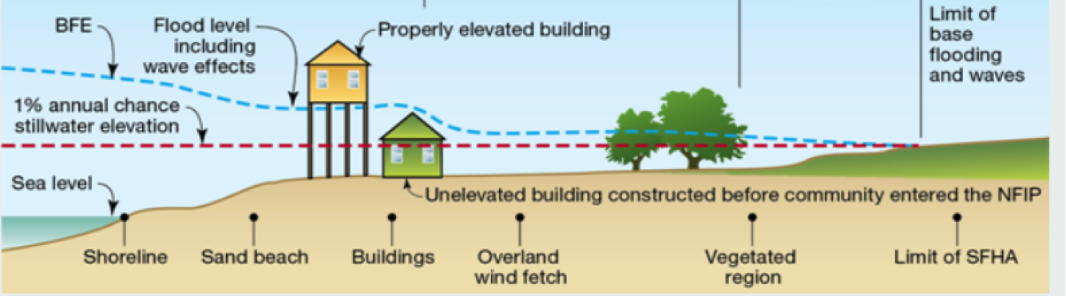
Figure 4: BFE
Notes:
Ref: http://www.riskmap3.com/node/998

